Slide 1
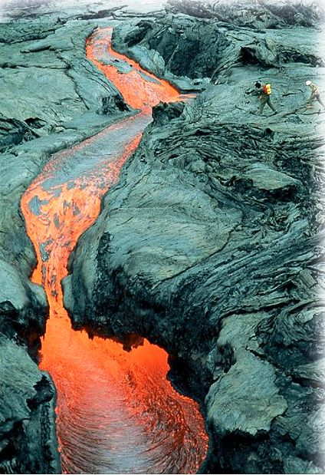
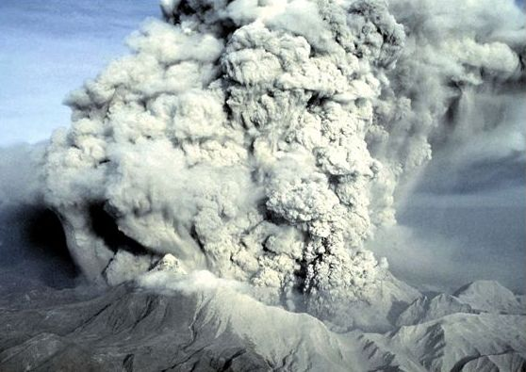
Igneous Petrology

Slide 2
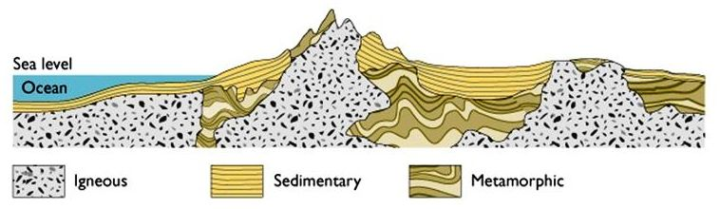
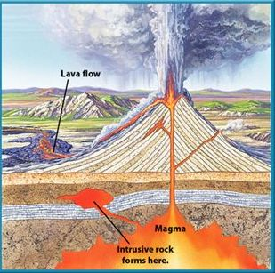
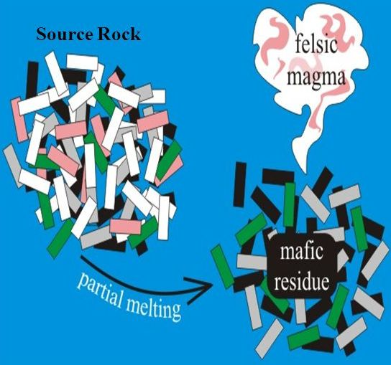
Formation of Igneous Rocks

Slide 3
Emplacement of magma below the surface followed by cooling and solidification- intrusive/plutonic rocks.
Emplacement of magma at shallow levels followed by cooling and solidification- hypabyssal rocks.
Eruption of magma on the surface followed by cooling and solidification- volcanic rocks.
A heterogeneous rock body, comprising minerals with different melting points, will undergo partial melting, i.e. the minerals with low melting point will melt first followed by the minerals having higher melting point. The melt that is generated and the “residue solid” both have different composition than the parent rock.

Slide 4
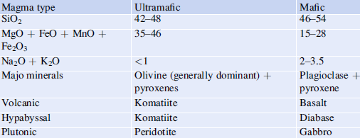
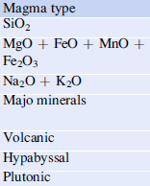
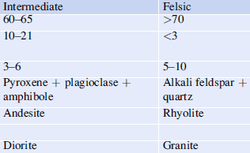

Slide 5
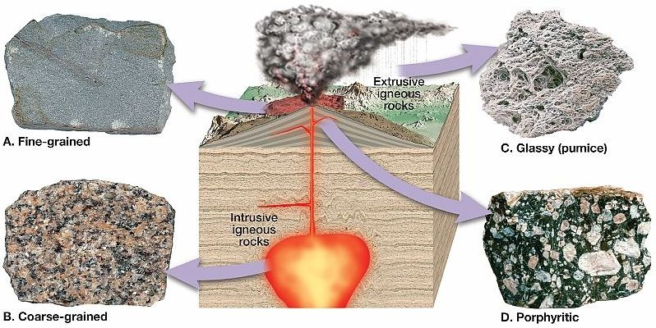

Slide 6
The plutonic rocks are usually coarse-grained which form at greater depths due to slow cooling.
The volcanic rocks are fine-grained formed at the surface by quenching of lava.
The hypabyssal rocks are characterized by porphyritic texture which results due to two-phase cooling- the coarse grains are formed at greater depths (known as phenocrysts) and the fine-grained matter (known as groundmass) is formed at shallow depths due to faster cooling.

Slide 7
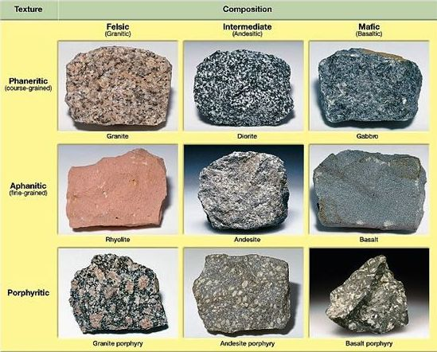

Slide 8
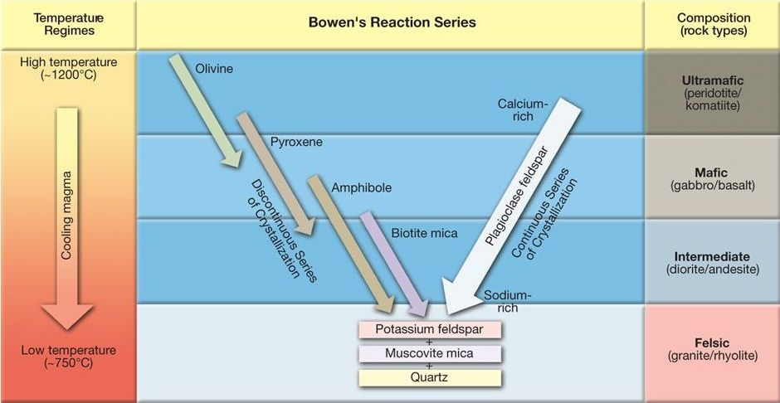
The sequential crystallization of minerals due to cooling of magma. In the discontinuous series, the high temperature minerals are eventually consumed and forms the next mineral in the series (for e.g. for a certain span of time, olivine and pyroxene will coexist and as the temperature further drops, olivine will be consumed completely leaving behind pyroxene). However, the plagioclase feldspar has a different pattern of evolution wherein the Ca is replaced by Na without forming any distinctly different mineral.

Slide 9
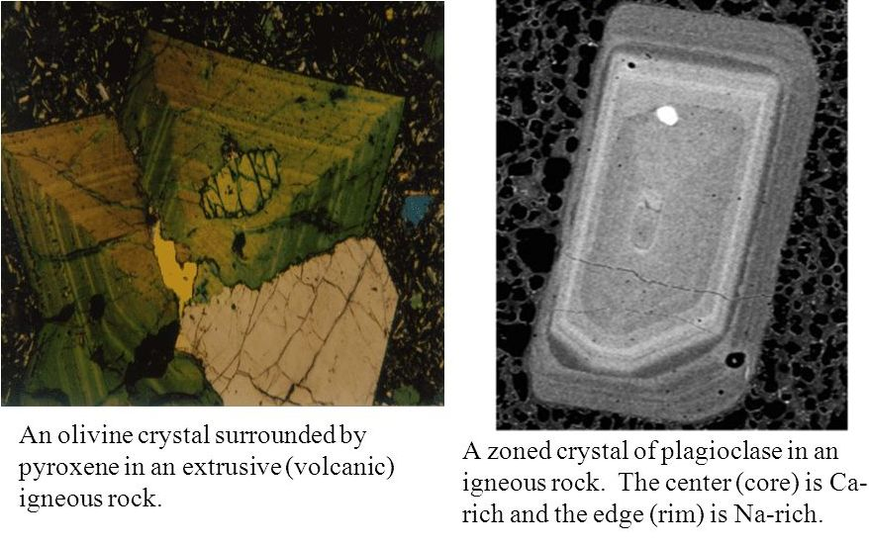
Bowen’s Reaction in action

Slide 10
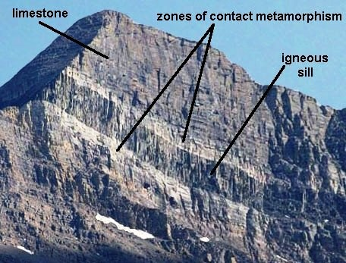
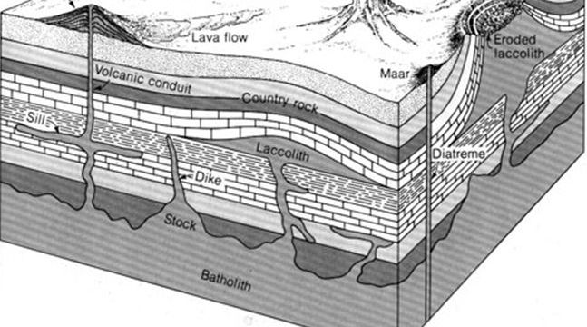
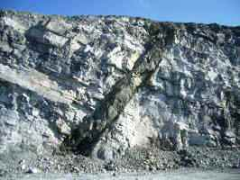
Structures of Igneous Rocks- Plutonic Bodies
Dyke

Slide 11
Sill is a concordant body formed by the penetration of magma parallel to the bedding planes. Basic magmas have low viscosity hence can flow easily and mostly occur as sills. Dykes are discordant bodies that cut across bedding planes. Sills and dykes are formed when during upward journey of magma, weak planes such as fractures, joints or crevices are encountered. Laccolith is a concordant igneous body with a flat base and convex upward top. When viscous magma rises through country rock, laccoliths are formed since the magma cannot flow easily and through longer distances and accumulates forming the laccoliths. Laccoliths particularly form when the supply of magma from below is more than can be accommodated by lateral spreading. When sedimentary rocks are folded, the crests and troughs may be occupied by magmatic intrusions which look like crescentic or lens shaped bodies known as phacoliths. Batholiths are largest intrusive igneous bodies that characteristically occur in mountain regions and are considered as roots of mountains. They extend at great depths and since these are deep-seated bodies, they might be exposed only after prolonged erosion.

Slide 12
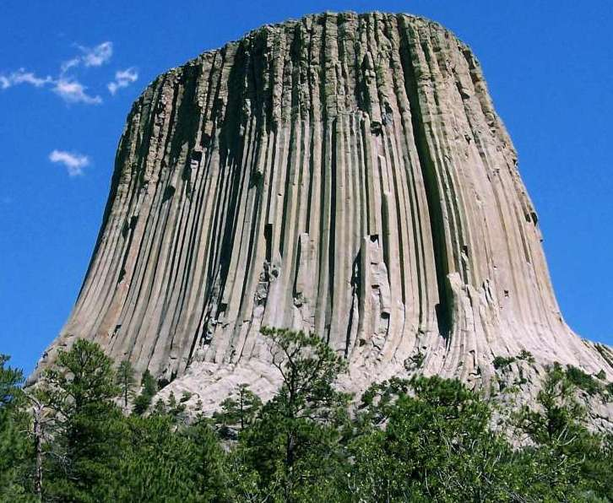
Devil’s Tower- A Laccolith or Volcanic Neck?

